Slide 1
ARMEK – Agentic AI-Powered Loan Underwriting and Risk Assessment System
Kuppam Engineering College · Department of Computer Science and Engineering · Academic Year: 2026–2027
Abstract
Team Members
ARMEK is an AI-powered financial services system designed to simplify loan application processing and risk assessment. It uses a multi-agent architecture in which a Master Agent coordinates specialized worker agents to process applicant information, perform eligibility checks, carry out verification workflows, assess credit-related risk and generate loan-related documents.
The system combines a React frontend, FastAPI backend and OpenAI GPT-4o-mini integration to support an organized and conversational loan processing experience.
Y N PAWANKALYAN
V RAMYA
C NANDINI
S DILLI RAJESH

Slide 2

BACKGROUND
Introduction
Loan underwriting is the foundational process by which financial institutions evaluate a borrower's eligibility and repayment capacity. Understanding the limitations of traditional approaches motivates the design of ARMEK.
The Traditional Landscape
The Case for AI-Assisted Processing
1
Eligibility Evaluation
1
Information Inconsistency
Loan underwriting involves evaluating a borrower's eligibility and repayment capacity against defined financial criteria.
Inconsistent or incomplete applicant information can make structured assessment more difficult without automated validation.
2
Multi-Stage Document Review
Traditional loan processing involves several checks and document reviews across multiple departments and personnel.
2
AI as a Processing Layer
AI can support information processing and structured decision workflows, reducing reliance on purely manual coordination.
3
Time and Coordination Costs
Manual processing can require considerable time and coordination, creating friction for both applicants and institutions.
3
ARMEK's Contribution
ARMEK brings these activities together through an agent-based system, unifying eligibility, verification and document generation into a single orchestrated pipeline.

Slide 3
PROJECT GOALS
Objectives
Main Objective: To develop an AI-powered loan underwriting system that organizes applicant information processing, verification workflows and risk assessment through a multi-agent architecture.
Specific Objectives
1
User Interface
Provide a user-friendly loan application interface accessible to applicants without technical expertise.
2
Information Collection
Collect and process applicant information in a structured and validated manner through the backend pipeline.
3
Agent Coordination
Coordinate loan assessment through a Master Agent that delegates tasks to specialized worker agents.
4
Eligibility & Verification
Perform eligibility and verification checks as discrete, auditable steps within the processing workflow.
5
Risk & Fraud Assessment
Support credit-related risk assessment and fraud checks to inform the underwriting decision.
6
Document Generation
Generate loan-related documents and display application status clearly through the interface.

Slide 4


ACADEMIC FOUNDATION
Literature Survey
Three peer-reviewed research papers form the academic basis for ARMEK's design, establishing the viability of machine-learning and AI methods in loan underwriting and credit-risk prediction.
2020 · ROYAL SOCIETY OPEN SCIENCE
2021 · SCIENTIFIC REPORTS
2022 · FINANCIAL INNOVATION
Turiel & Aste — Peer-to-Peer Loan Acceptance and Default Prediction with Artificial Intelligence
Xu, Lu & Xie — Loan Default Prediction of Chinese P2P Market: A Machine Learning Methodology
Alonso Robisco & Carbó Martínez — Measuring the Model Risk-Adjusted Performance of ML Algorithms in Credit Default Prediction
Royal Society Open Science, 7(6), 191649. Uses machine-learning methods including logistic regression, support vector machines and deep neural networks applied to P2P lending data.
Key Finding: AI-based models can support loan acceptance decisions and default-risk prediction, demonstrating the feasibility of algorithmic underwriting.
Scientific Reports, 11, 18759. Compares machine-learning methods such as Random Forest, Gradient Boosting and Neural Networks on Chinese P2P lending datasets.
Key Finding: Machine-learning methods can help identify factors associated with loan repayment risk, supporting feature-driven credit assessment.
Financial Innovation, 8, 70. Studies machine-learning models for credit-default prediction and examines both predictive performance and associated model risks.
Key Finding: Models such as Random Forest and XGBoost can be useful for credit-default prediction, but model risk and validation are critically important considerations.

Slide 5
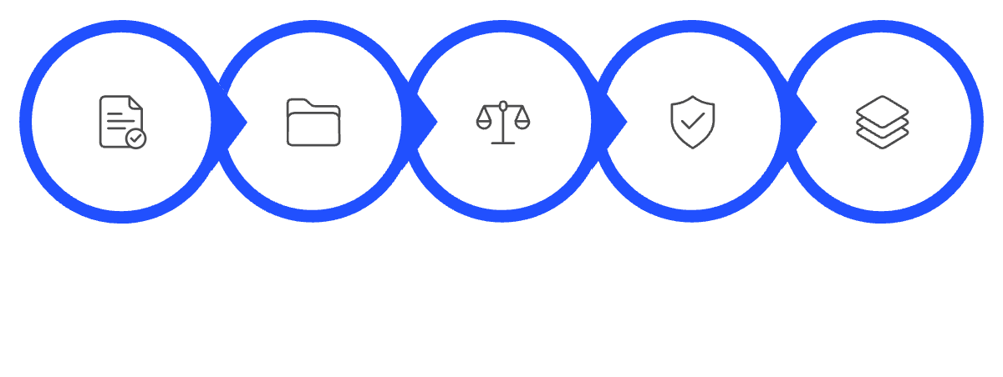

STATUS QUO
Existing System
Conventional loan processing follows a sequential, largely manual workflow. Understanding this baseline is essential to appreciating the structural improvements ARMEK introduces.
Conventional Loan Processing Workflow
Advantages of the Existing System
Established lending procedures with regulatory familiarity
Human review available for complex or edge-case applications
Apply
Collect Docs
Assess Eligibility
Credit Check
Stage Reviews
Familiar verification processes accepted by institutions
Suitable for standard banking workflows and compliance frameworks
Disadvantages of the Existing System
Multiple manual processing stages increase turnaround time
Repeated document handling across departments
Coordination overhead between different review teams
Delays may occur during application review and escalation
Limited automation in some verification and assessment workflows

Slide 6

PROPOSED SOLUTION
Proposed System: ARMEK
ARMEK – Agentic AI-Powered Loan Underwriting and Risk Assessment System addresses the limitations of conventional processing through a coordinated multi-agent architecture backed by modern web technologies.
Key System Components
Agent Workflows
React Interface
FastAPI Backend
1
Eligibility Agent
React-based frontend for structured applicant interaction and real-time status display.
Python FastAPI backend handling application processing, routing and Pydantic-validated data models.
Evaluates applicant financial criteria against defined eligibility thresholds.
2
State Reconciliation Agent
GPT-4o-mini Integration
Master Agent
Reconciles applicant-provided information for consistency across the application.
OpenAI GPT-4o-mini integration enabling conversational AI processing within the underwriting pipeline.
Central orchestrator coordinating all specialized worker agents across the assessment workflow.
Credit Bureau Agent
3
Performs simulated credit-related verification checks within the processing pipeline.
4
Fraud Detection Agent
Applies fraud-detection logic to flag anomalous or inconsistent application data.
Document Generation Agent
5
Produces loan-related documents using ReportLab and pypdf upon workflow completion.
Technology Stack: React.js 19 · Bootstrap 5 · Axios · Python FastAPI · Uvicorn · OpenAI API · Pydantic · ReportLab · pypdf

Slide 7







SYSTEM BENEFITS
Proposed System: Advantages
ARMEK's multi-agent design delivers structural improvements over conventional loan processing by distributing responsibilities across specialized agents coordinated by a single Master Agent.
Organized Multi-Agent Workflow
Reduced Manual Coordination
Processing tasks are distributed across specialized worker agents, each with a clearly defined responsibility, reducing the risk of bottlenecks in any single stage.
Repetitive manual coordination steps are replaced by automated agent handoffs orchestrated by the Master Agent, streamlining the overall workflow.
Centralized Information Processing
Conversational AI Interaction
Applicant information is collected, validated and processed through a single backend pipeline, reducing duplication and inconsistency across stages.
GPT-4o-mini integration enables a conversational interface, making the application process more accessible and guided for end users.
Separation of Concerns
Clear Status and Document Output
Each worker agent holds a distinct responsibility — eligibility, reconciliation, credit checks, fraud detection or document generation — enabling modular development and testing.
The system provides a transparent application status view and generates loan-related documents automatically upon workflow completion.

Slide 8
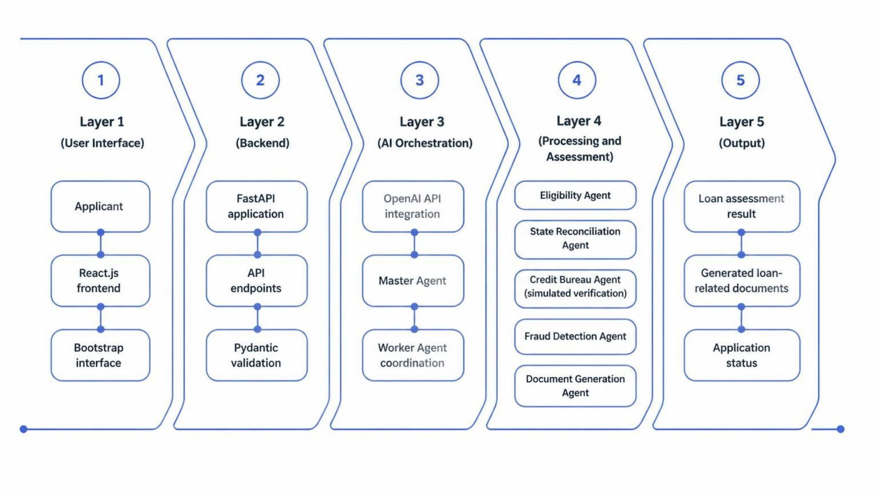

TECHNICAL DESIGN
System Architecture
ARMEK is structured as a five-layer architecture, separating user interaction, backend processing, AI orchestration, specialized agent assessment and output generation into distinct, well-defined tiers.
Layer 1
Layer 2
Layer 3
Layer 4
Layer 5
User Interface
React.js · Bootstrap 5 · Axios
Backend
FastAPI · Uvicorn · Pydantic
AI Orchestration
OpenAI GPT-4o-mini · Master Agent
Agent Processing
5 Specialized Worker Agents
Output
Assessment · Documents · Status
The Credit Bureau Agent performs simulated verification checks within the ARMEK pipeline. It does not connect to live government or banking data sources.

Slide 9

COMPARATIVE ANALYSIS
Existing vs. Proposed System: Comparison
The table below summarizes the structural differences between conventional manual loan processing and the ARMEK multi-agent approach across key operational dimensions.
Dimension | Existing System | ARMEK (Proposed)
Processing Model | Sequential, largely manual stages | Parallel, agent-coordinated pipeline
Coordination | Inter-departmental handoffs required | Master Agent orchestrates all handoffs
Applicant Interaction | Form submission and manual follow-up | Conversational AI-guided interface
Verification Checks | Manual credit and identity review | Simulated checks via Credit Bureau Agent
Fraud Detection | Reviewer-dependent assessment | Dedicated Fraud Detection Agent
Document Generation | Manual document preparation | Automated via Document Generation Agent
Status Visibility | Communicated at end of process | Displayed in real time through the interface
Technology Basis | Standard banking workflows | React · FastAPI · OpenAI GPT-4o-mini

Slide 10



ACADEMIC SOURCES
References
Research Papers
1
2
3
Turiel, J. D., & Aste, T. (2020). Peer-to-peer loan acceptance and default prediction with artificial intelligence. Royal Society Open Science, 7(6), 191649.
https://doi.org/10.1098/rsos.191649
Xu, J., Lu, Z., & Xie, Y. (2021). Loan default prediction of Chinese P2P market: a machine learning methodology. Scientific Reports, 11, 18759.
https://doi.org/10.1038/s41598-021-98361-6
Alonso Robisco, A., & Carbó Martínez, J. M. (2022). Measuring the model risk-adjusted performance of machine learning algorithms in credit default prediction. Financial Innovation, 8, 70.
https://doi.org/10.1186/s40854-022-00366-1
Technical Documentation
React
FastAPI
OpenAI API
Bootstrap
https://react.dev/
https://fastapi.tiangolo.com/
https://platform.openai.com/docs/
https://getbootstrap.com/docs/

